Slide 1
CS 211 Computer Architecture Lecture 10: ISA – RISC vs CISC
Ravi Mittal
ravi.mittal@iitgoa.ac.in
Indian Institute of Technology, Goa

Slide 2
Acknowledgements
Computer Organization and Design, Fifth Edition: The Hardware/Software Interface”, D. A. Patterson and J. L. Hennessy, Morgan Kaufmann Publishing
RISC vs CISC, Stanford University https://cs.stanford.edu/people/eroberts/courses/soco/projects/risc/risccisc/
CS61C Introduction to Machine Language, Course CS61C, Great Ideas in Computer Architecture, Instructor Branden Ghena, July 2019

Slide 3
In today’s class we will study
Assembly / Machine Instructions - Basics

Slide 4
Assembly/Machine Instructions - Basics

Slide 5
Assembly (Also known as: Assembly Language, ASM)
A low-level programming language where the program instructions match a particular architecture’s operations
Splits a program into many small instructions that each do one single part of the process
C program
a = (b+c)-(d+e);
Assembly program
add t1, s3, s4
add t2, s1, s2
sub s0, t2, t1

Slide 6
There are many assembly languages
Each architecture will have a different set of operations that it supports
Although there are many similarities
Assembly is not portable to other architectures (like C is)

Slide 7



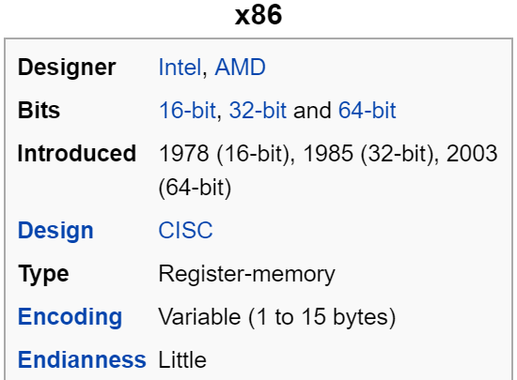
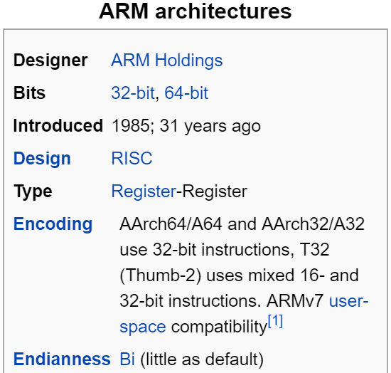
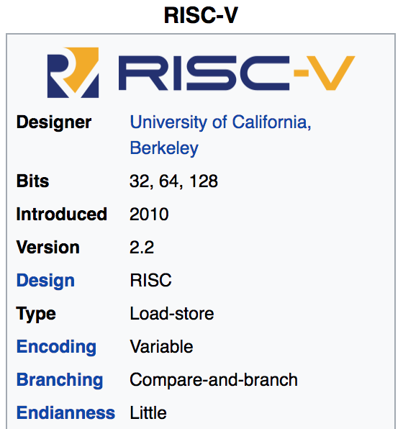
Mainstream Instruction Set Architectures
Macbooks & PCs
(Core i3, i5, i7, M)
x86 Instruction Set
Smartphone-like devices
(iPhone, Android), Raspberry Pi, Embedded systems
ARM Instruction Set
Versatile and open-source
Relatively new, designed for cloud computing, embedded systems, academic use RISCV Instruction Set
Notes:
We have many choices as to which assembly language we could pick:
intel x86, which is the machine language used by most of our laptops.
Why don’t we?
SUPER long and complicated
Arm, which is used in our iphone
ARM stands for Advanced RISC Machine

Slide 8
Which instructions should an assembly include?
There are some obviously useful instructions:
add, subtract, and, bit shift
read and write memory
But what about:
only run the next instruction if these two values are equal
perform four pairwise multiplications simultaneously
add two ascii numbers together (‘2’ + ‘3’ = 5)

Slide 9
Complex Instruction Set Computing (CISC)

Slide 10
Complex Instruction Set Computing
Early trend: add more and more instructions to do elaborate operations:
Complex Instruction Set Computing (CISC)
difficult to learn and comprehend language
less work for the compiler
complicated hardware runs more slowly
Attempt was to reduce the semantic gap
Notes:
x86 fell victim to the “early trend” -- every time we want to do something complicated, let’s just implement it directly in the hardware! Downsides…
no one person can know the whole things
WHAT’S THE RULE ABOUT ASSEMBLY LANGUAGE?

Slide 11
Complex Instruction Set Computing
Complex instruction: An instruction does a lot of work, e.g. many operations
Insert in a doubly linked list
Compute FFT
String copy
Advantages of Complex instructions
+ Denser encoding → smaller code size
+ Useful in special purpose computers eg for AI, Data Mining, Graphics, etc

Slide 12
Complex Instruction Set Computing
Study of Instruction set architecture revealed
Compilers rarely make use of the complex instructions provided by CISC machines
Complex operations tended to be slower than a sequence of simpler operations doing the same thing
Often real-world programs spend most of their time executing simple operations
Implementing complex operations leads to complicated CPU architecture that slow down the execution of simple instructions
Worse: simple operations are slower even when you don’t use the complex operations
Complex hardware

Slide 13
Reduced Instruction Set Computing (RISC)

Slide 14
Reduced Instruction Set Computing
Opposite philosophy later began to dominate: Reduced Instruction Set Computing (RISC)
Simpler (and smaller) instruction set makes it easier to build fast hardware
Let software do the complicated operations by composing simpler ones
Optimise as much as possible the few instructions that are used the most in practise
Try and make them exceedingly fast
This makes the task of the compiler (much) harder, but the compiler has to compile a program only once, whereas the CPU would have to support complex instructions all the time

Slide 15
Reduced Instruction Set Computing
Simple instruction: An instruction does small amount of work, it is a primitive using which complex operations can be built
Add, XOR, Multiply, etc
Load – Store Architecture
RISC architectures are Load – Store architecture
External memory was only accessible by a load or store instruction
All other instructions are limited to internal registers
Advantages:
Drastic simplification of processor design
Fixed length Instructions
Simplified Pipelines
Simplified and more efficient Cache design

Slide 16
RISC vs CISC

Slide 17
Multiplication Example
Multiply two numbers in Memory
Consider 6 registers and Execution Unit
Multiply number at location 2:3 with number at location 5:2 and store the result at location 2:3
CISC Approach
Complete the task in as few lines of assembly code
Build hardware that is capable of understanding and executing as series of operation
Instruction: MULT – that will load two values in to separate registers

Slide 18
Multiplication Example – CISC Approach
Complete the task in as few lines of assembly code
Build hardware that is capable of understanding and executing as series of operation
Instruction: MULT –
Load two values in to separate registers
Multiply the operands in Execution Unit
Store the result in appropriate register
Entire task is completed in one instruction:
MULT 2:3, 5:2
MULT is a complex instruction
It operates directly on computer Memory and does not require explicit loading or storing function
This resembles HLL instruction: a = a * b
The length of the code is relatively short, very little RAM is required to store instructions

Slide 19
Multiplication Example – RISC Approach
RISC processors only use simple instructions that can be executed within one clock cycle
MULT command could be divided into three separate commands: LOAD – which moves data from memory bank to a register
PROD - product of two operands located within the registers
STORE - moves data from a register to the memory banks
LOAD A, 2:3 LOAD B, 5:2 PROD A, B STORE 2:3, A
Simple instructions can be executed at high speed – one instruction in one cycle
More RAM is required

Slide 20
RISC
Each instruction requires one cycle to execute
Simple RISC instructions require less transistors to implement hardware
More room is available for Registers
All instructions execute in a uniform amount of time → pipelining is possible
Separating Load and Store reduces amount of work
Less number of instructions
Faster clock → small cycle time
The operand will remain in the register until another value is loaded in its place → Advantage when the operand is used again in the next instruction
RAM Size is not a concern any more

Slide 21
RISC
Shorter design time
Better use of Chip Space
Greater Speed
Assembly doesn’t need to closely match with HLL

Slide 22
CISC
Less use of Registers
Less number of registers – as hardware takes up most of the space
Instructions require multiple clock cycles for completion
Memory-to-memory: "LOAD" and "STORE" incorporated in instructions
Small code sizes

Slide 23
Historical Perspective

Slide 24
CISC and RISC Historical Perspective
CISC processor came first; RISC processor came in early 1980s
Original reasons for CISC
Memory was small and expensive : So small program was a positive
Programmers were working in assembly. They were able to take full advantage of more complex instructions in programming
Large amount of legacy x86 code (e.g. Microsoft products)
Locking PC users into x86 CISC. x86 has been backwards
Compatible back to the 8080 processor (1974)
Under the hood’ modern Intel processors are also RISC:
Complicated x86 machine instructions are translated at run-time into much simpler underlying RISC microcode
not user-visible

Slide 25
CISC and RISC Historical Perspective
Despite RISC advantages argument arose, CISC remained dominant due to
Legacy and commercial interest (example - Intel)
Lack of major initial support to take a risk with RISC
In the last two decades, RISC processor grew in presence and numbers
Today’s market place is significantly shaped by smartphones and tablets
Energy and power are major design constraints

Slide 26
Special Purpose Processors

Slide 27
Special Purpose Processors
Sometimes a workload is so extremely skewed towards certain commands that it makes sense to abandon traditional CPU architecture (including RISC) and use special purpose processors
GPUs (graphics processing unit)
Designed to exploit high degree of SIMD parallelism in graphics and image processing algorithms
Bitcoin lead to dedicated chips that compute nothing but SHA256 (Hash Function)
Google’s TPU (Tensor Processing Units)
Basically matrix multiplication and activation function engine

Slide 28
Lecture Summary
RISC vs CISC debate continues
RISC architecture
Simple and Uniform Instructions
Fast Operations
More Registers
Load – Store Architecture
Efficient use of hardware
CISC Architecture
Less HLL code size
Complex instructions – Instructions try to do too many things
Complex hardware
Legacy reasons

